Slide 1
Display Calibration
(Do I need to do this?)

Slide 2
Display Calibration
Do I need to calibrate my display?

Slide 3
Display Calibration
Do I need to calibrate my display?
No, if you only process photos for web (Facebook, Instagram, etc.), or to send to family/friends, or display on your tablet, computer, or smartphone.

Slide 4
Display Calibration
Do I need to calibrate my display?
No, if you only process photos for web (Facebook, Instagram, etc.), or to send to family/friends, or display on your tablet, computer, or smartphone.
Yes, if you are printing photos, or sending out for printing.

Slide 5
Display Calibration
Common Printing Problems:
Prints are too dark

Slide 6
Display Calibration
Common Printing Problems:
Prints are too dark
The color is off

Slide 7
Display Calibration
Common Printing Problems:
Prints are too dark
The color is off
Calibrating your display and using ICC profiles with your printer will correct these problems.

Slide 8
Display Calibration
Viewing Room Conditions:
Dim to moderate indirect lighting
No direct sunlight in room
No lighting directed to display
No strong colors on walls

Slide 9
Display Calibration
Luminance
A photometric measure of the luminous intensity per unit area of light travelling in a given direction.
Expressed as candelas per square meter (cd/m²).
LED monitors can have a luminance as high as 300 cd/m².
Displays calibrated for printing need to be set to a luminance in the range of 100-120 cd/m²

Slide 10
Display Calibration
Items needed to calibrate your display:
A spectrophotometer
Software program for calibration

Slide 11
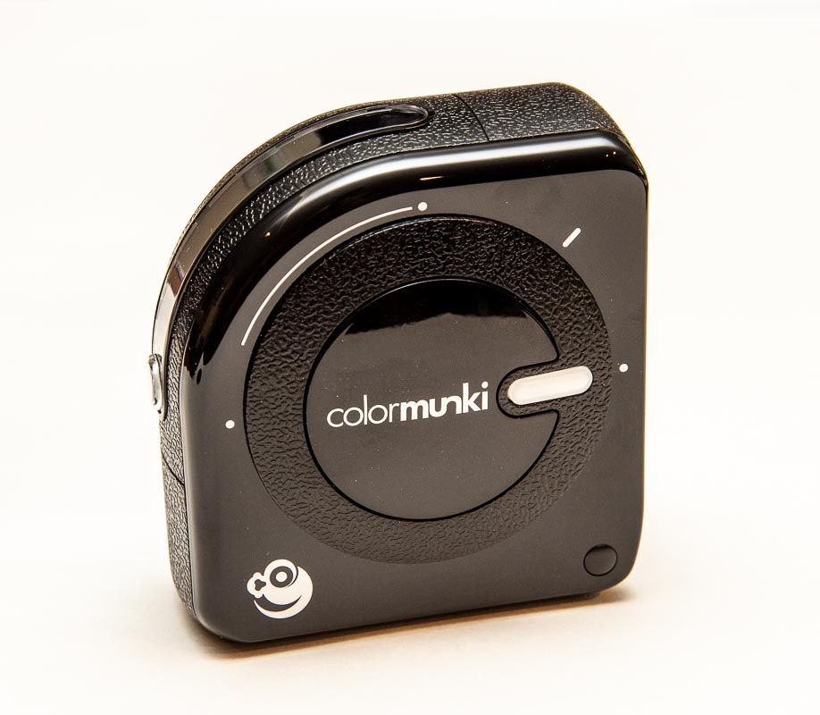
Display Calibration
ColorMunki Photo

Slide 12
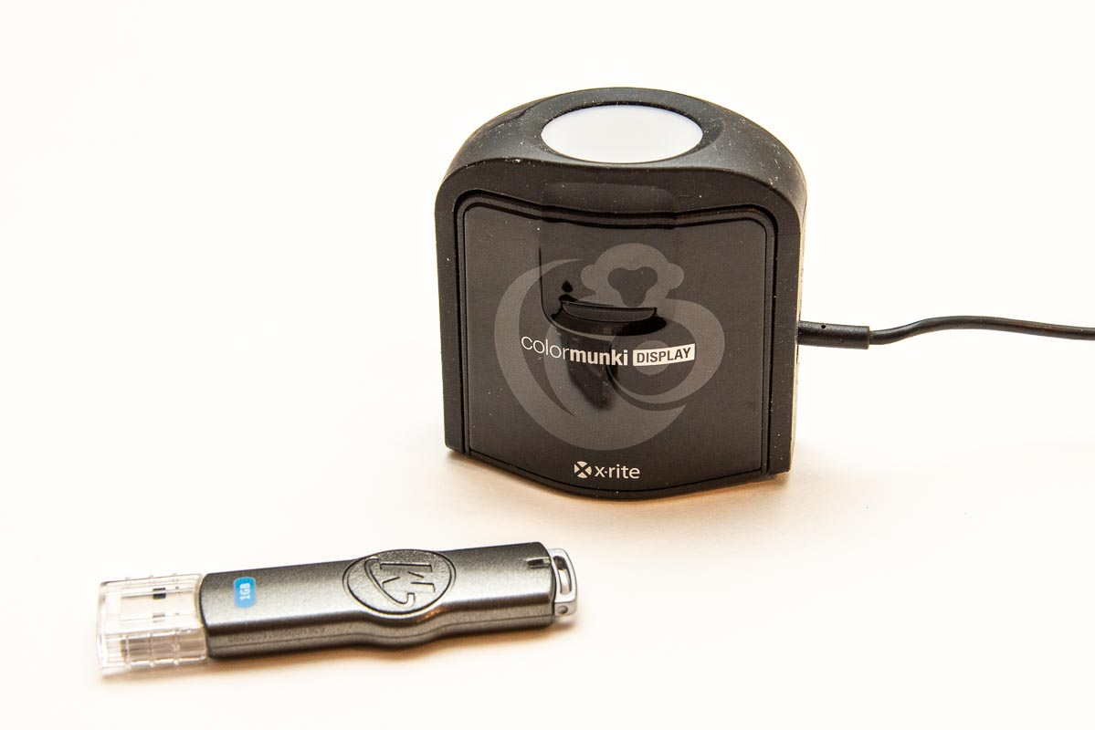
Display Calibration
Display Calibrator

Slide 13
Display Calibration
A ColorMunki Display and software is available for borrowing:
For current Rockbridge Camera Club members that have paid club dues
Contact Bob Kovach, email bobkovach1@gmail.com

Slide 14
Display Calibration
Install i1Studio software:
Windows: i1StudioSetup v1.5.1 (PC)
Mac: i1Studio ver1.5.1 (mac)
The software is on the flash drive

Slide 15
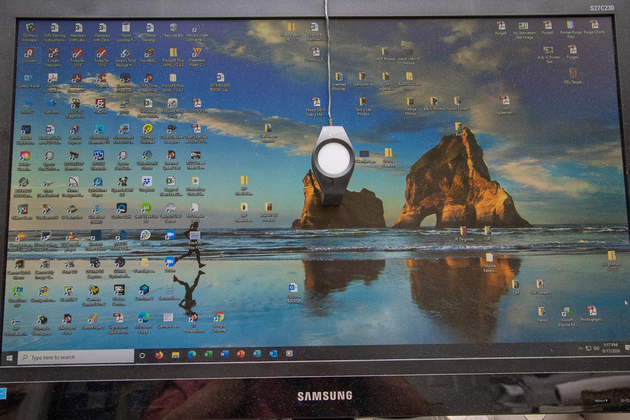
Display Calibration
Placement on Your Monitor

Slide 16
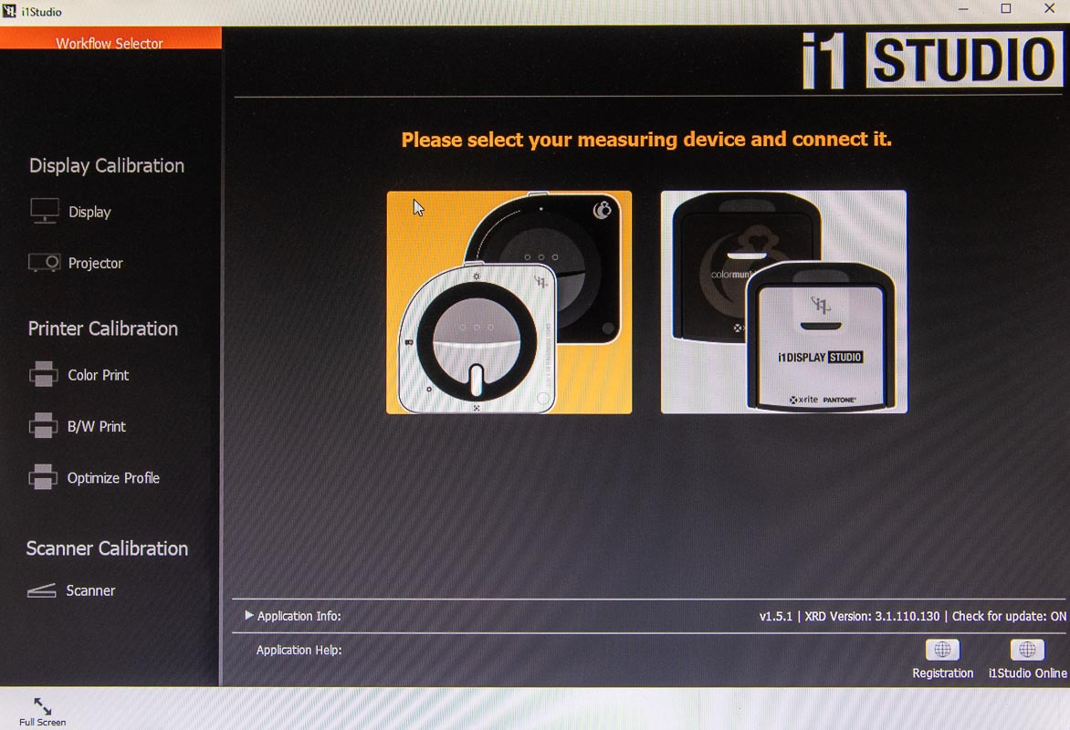
Display Calibration
Select the i1Display Studio

Slide 17
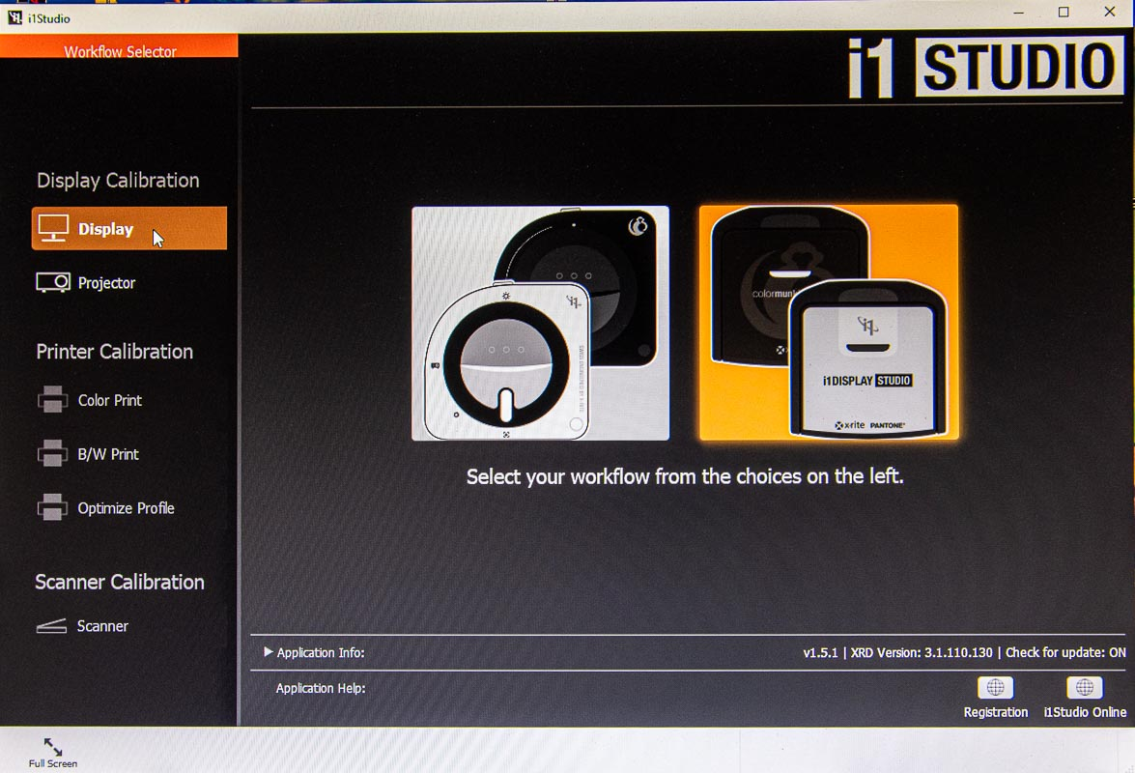
Display Calibration
Select Display

Slide 18
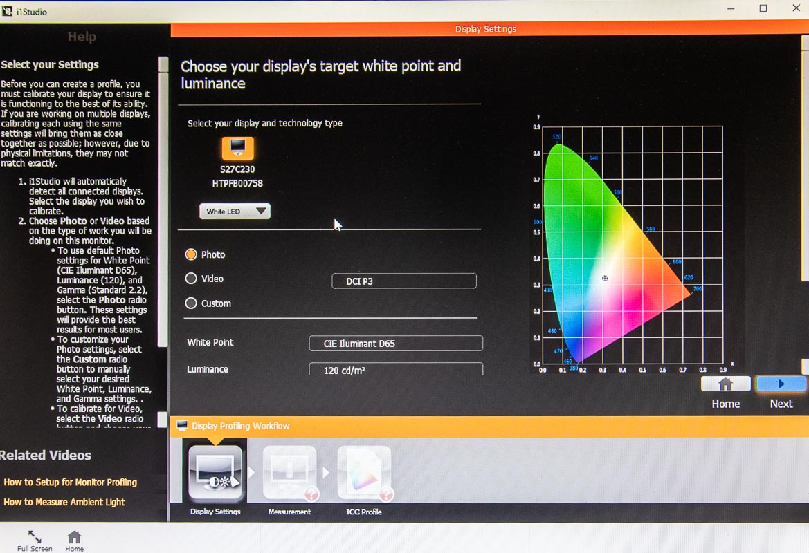
Display Calibration
Select White LED and Photo

Slide 19
Display Calibration
Click Next

Slide 20
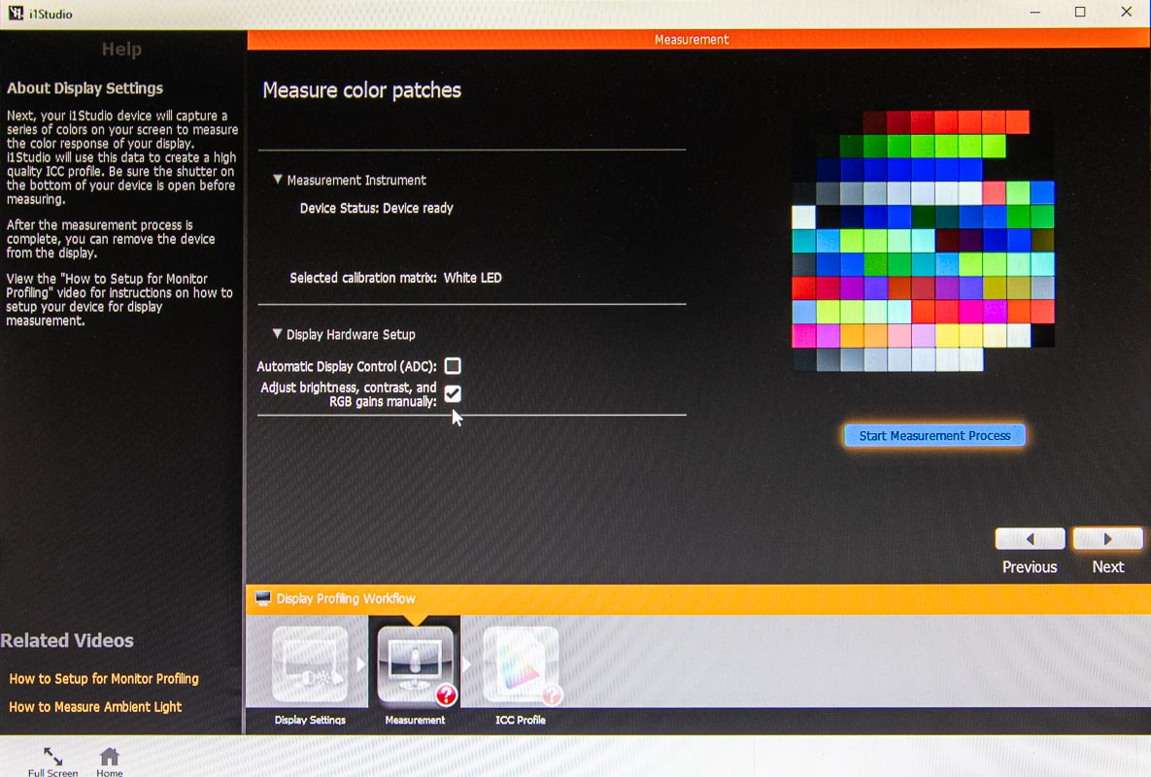
Display Calibration
Select Adjust brightness, contrast,…

Slide 21
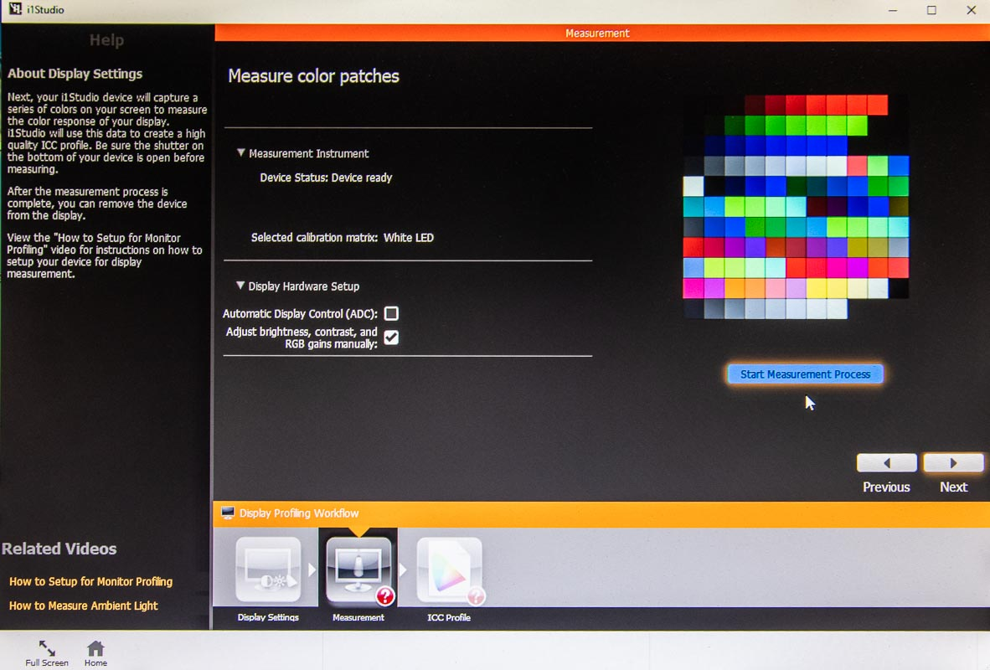
Display Calibration
Click Start Measurement Process

Slide 22
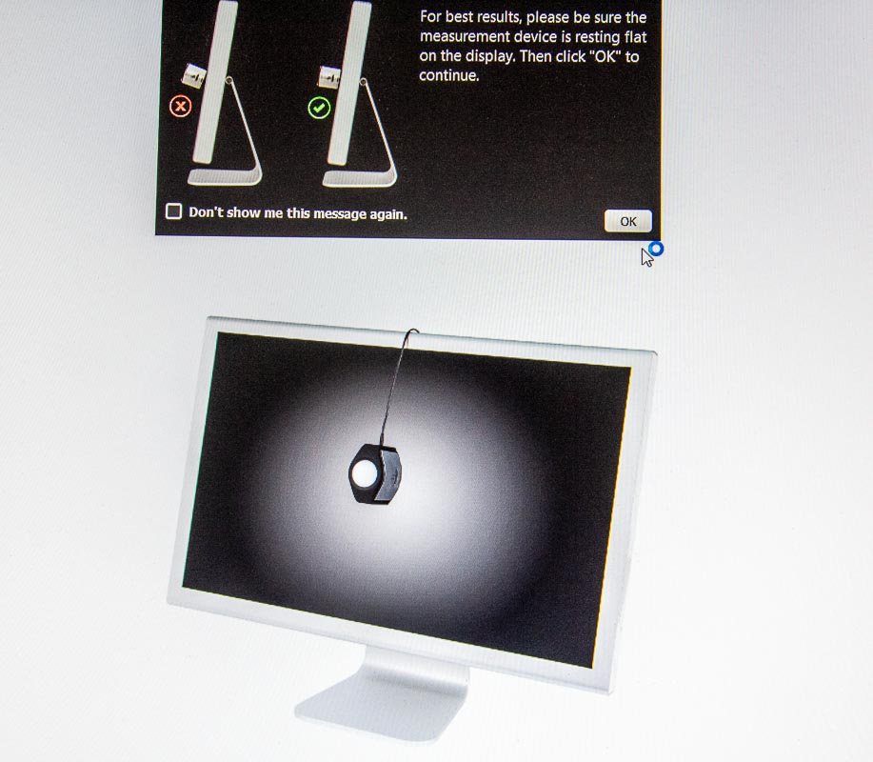
Display Calibration
Placement of the ColorMunki Display on your monitor

Slide 23
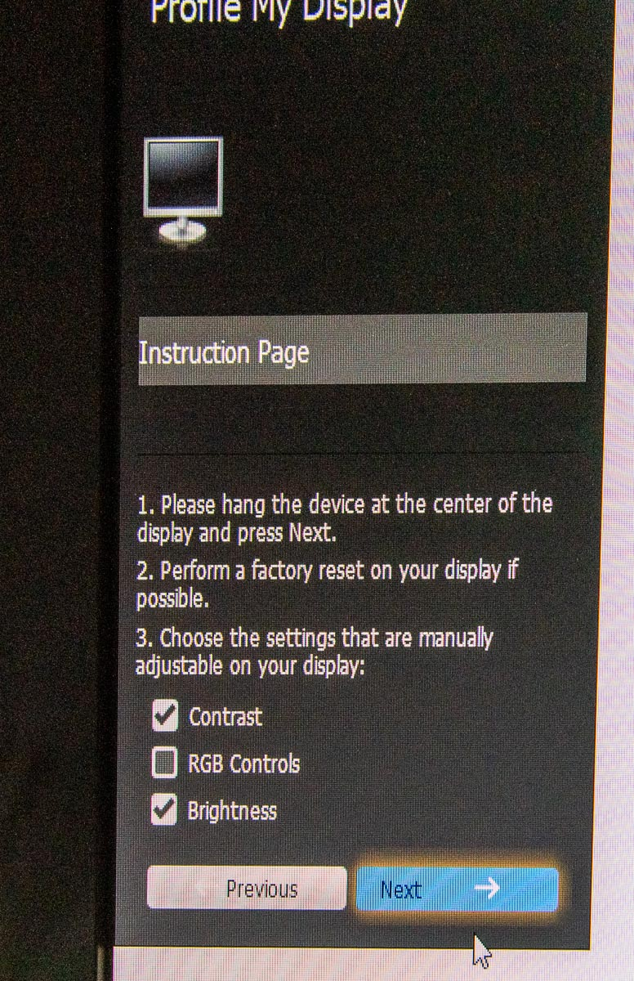
Display Calibration
Select Contrast and Brightness, then click Next

Slide 24
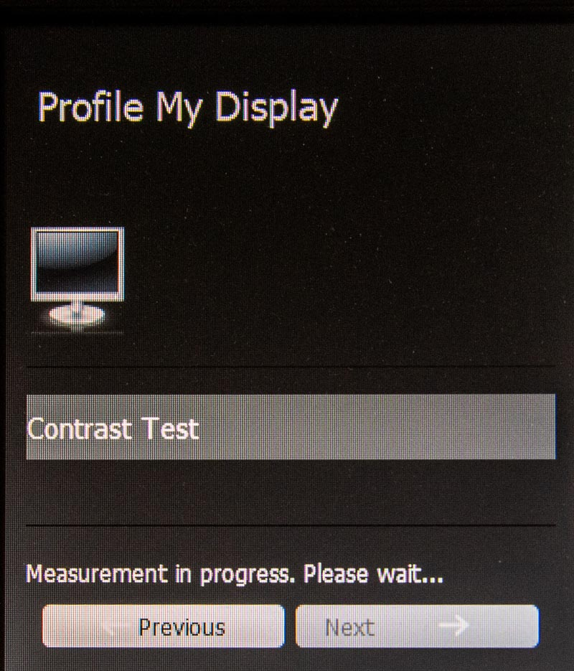
Display Calibration
Performing the contrast adjustment

Slide 25
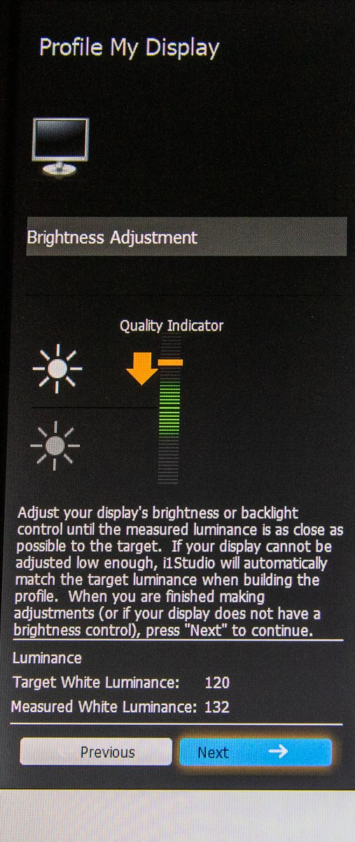
Display Calibration
Brightness – The screen is too bright

Slide 26
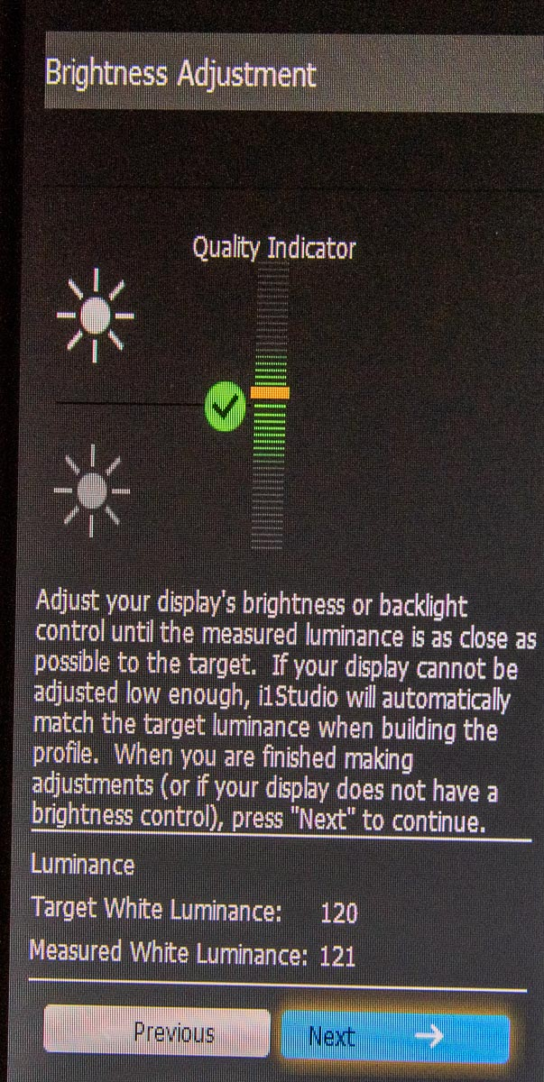
Display Calibration
Brightness – Properly adjusted

Slide 27
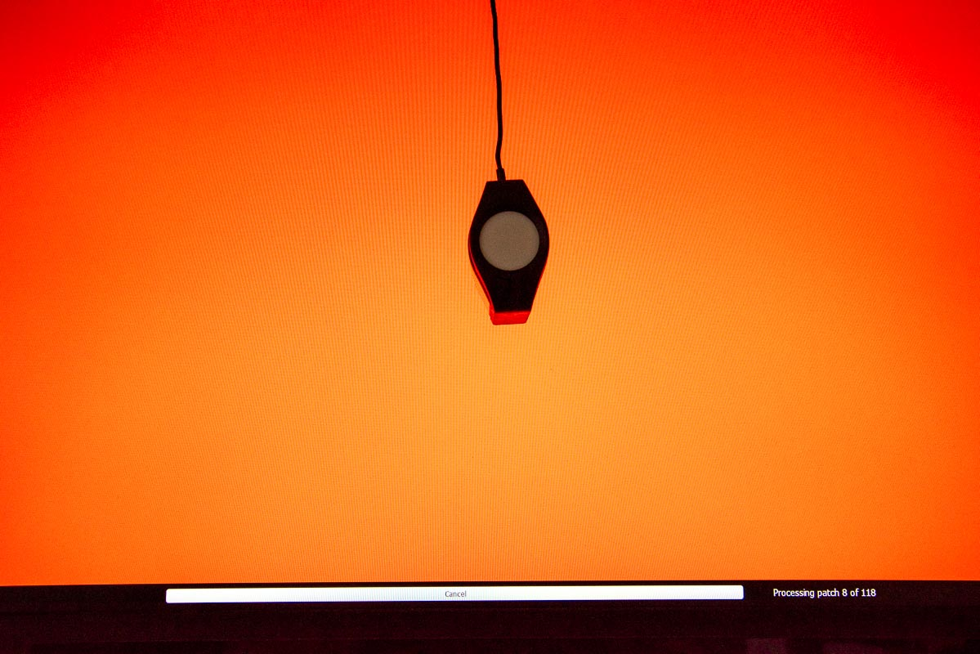
Display Calibration
Calibrating . . .

Slide 28
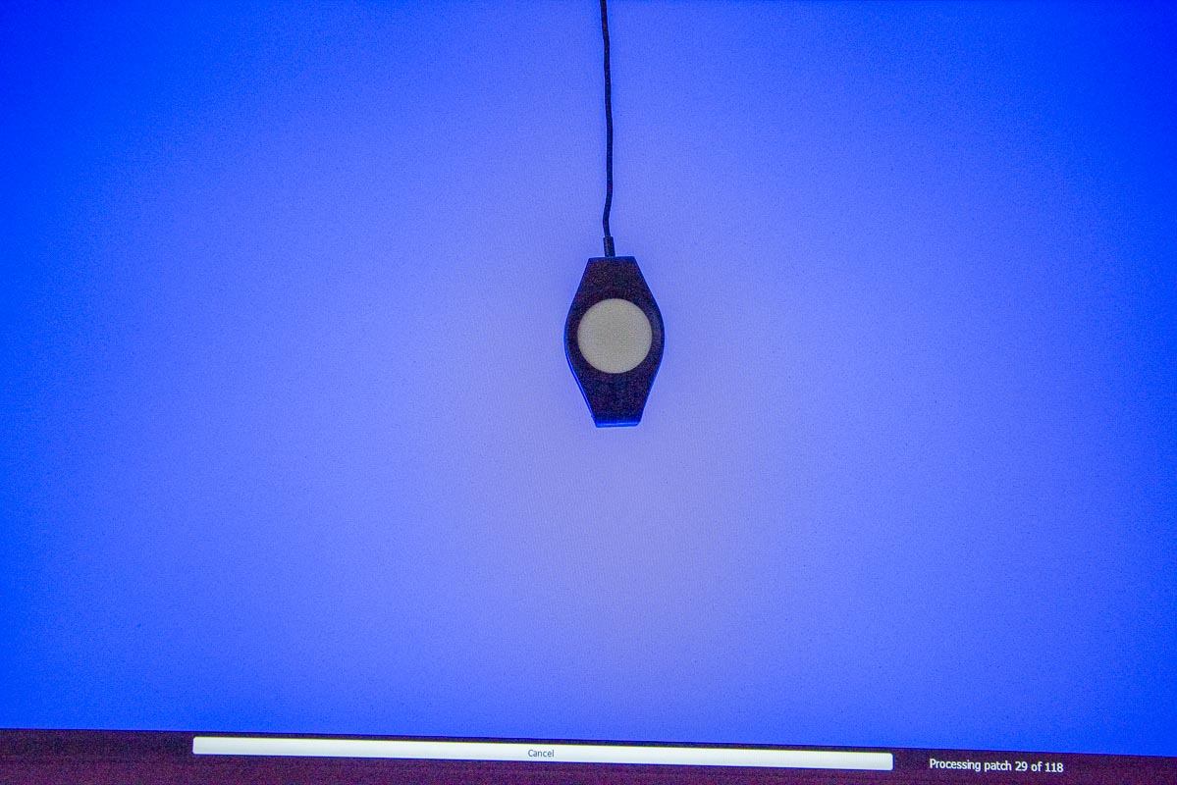
Display Calibration
Calibrating . . .

Slide 29
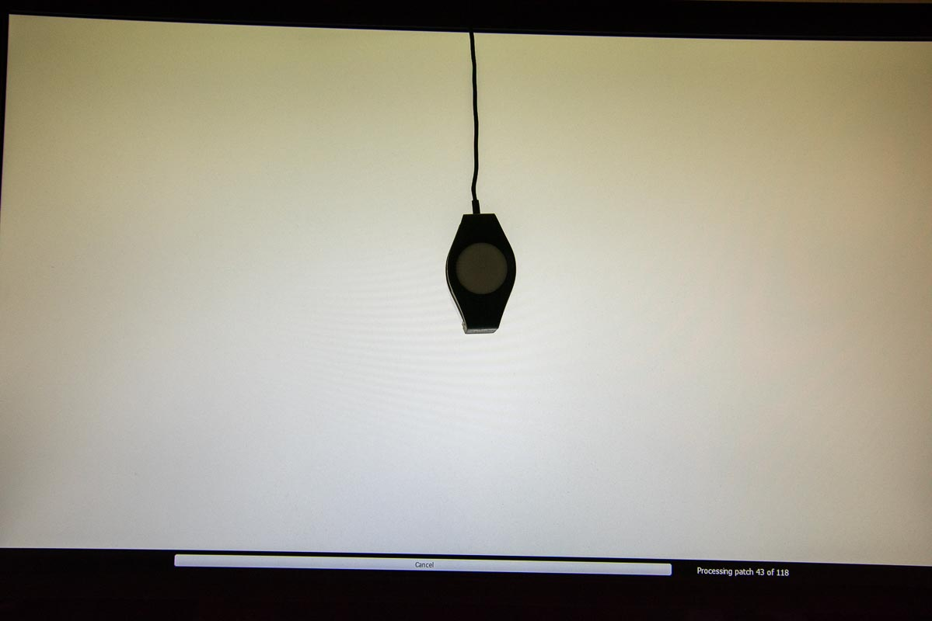
Display Calibration
Calibrating . . .

Slide 30
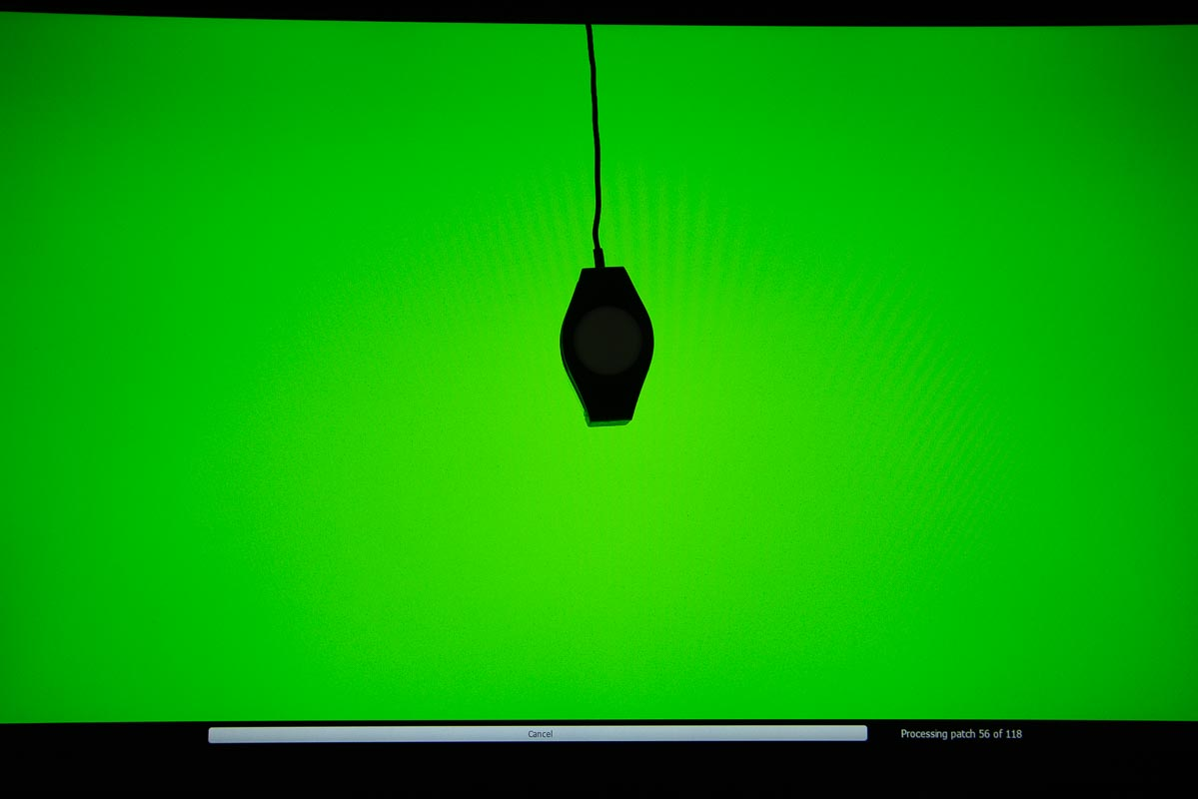
Display Calibration
Calibrating . . .

Slide 31
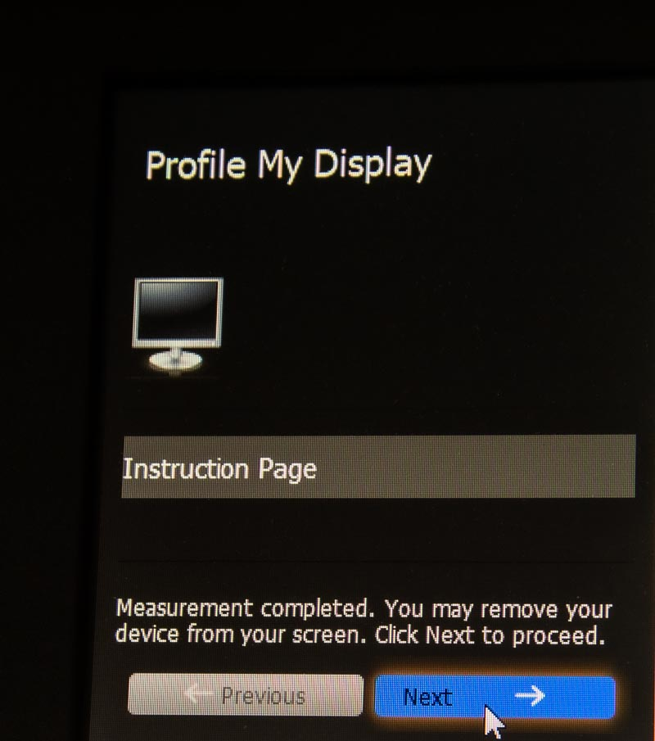
Display Calibration

Slide 32
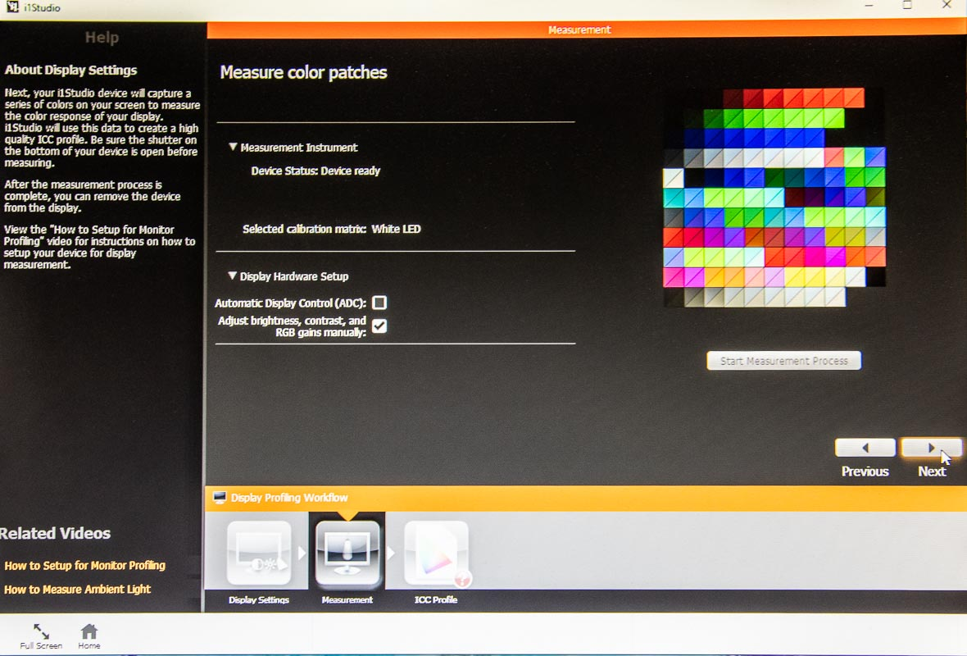
Display Calibration
Click Next

Slide 33
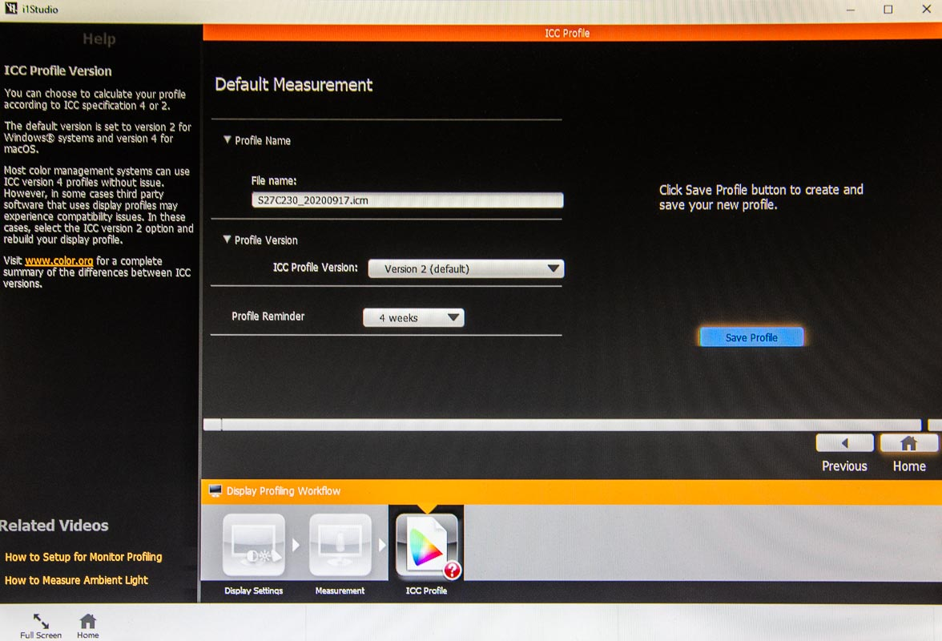
Display Calibration

Slide 34
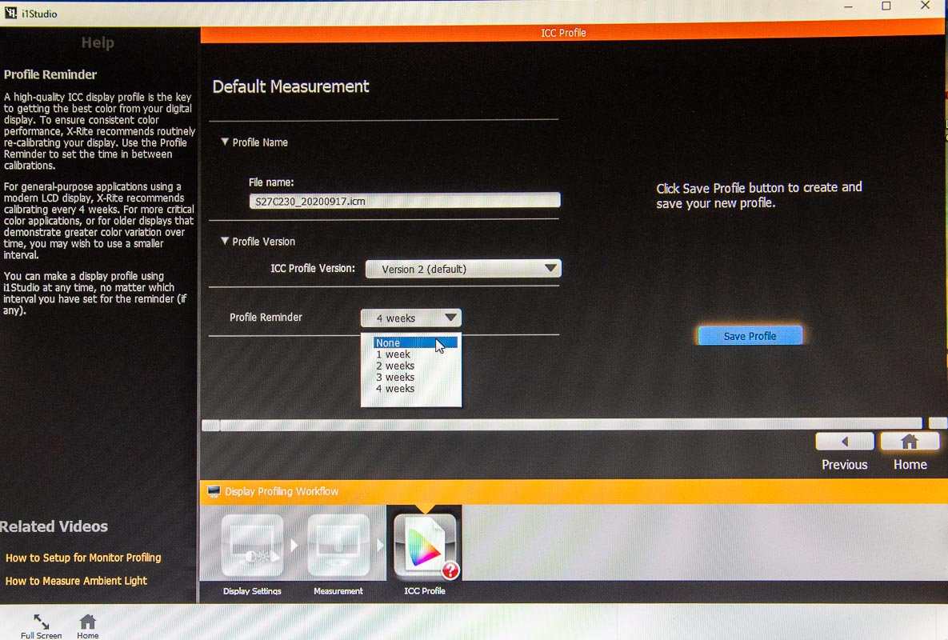
Display Calibration
Select None for Profile Reminder

Slide 35
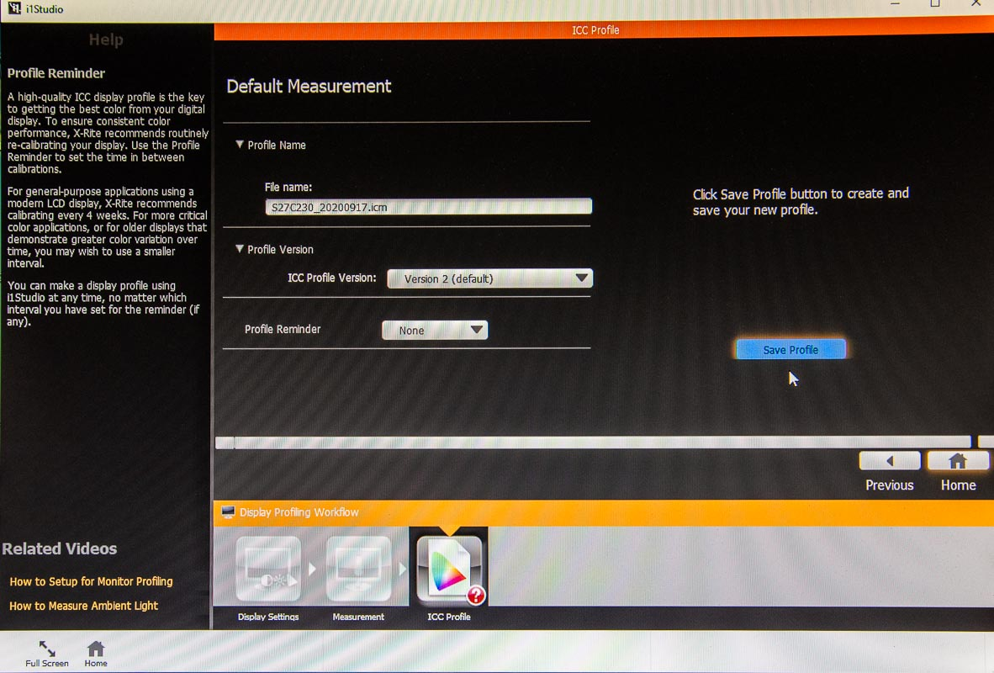
Display Calibration
Do not change File name or Profile Version – Click Save Profile

Slide 36
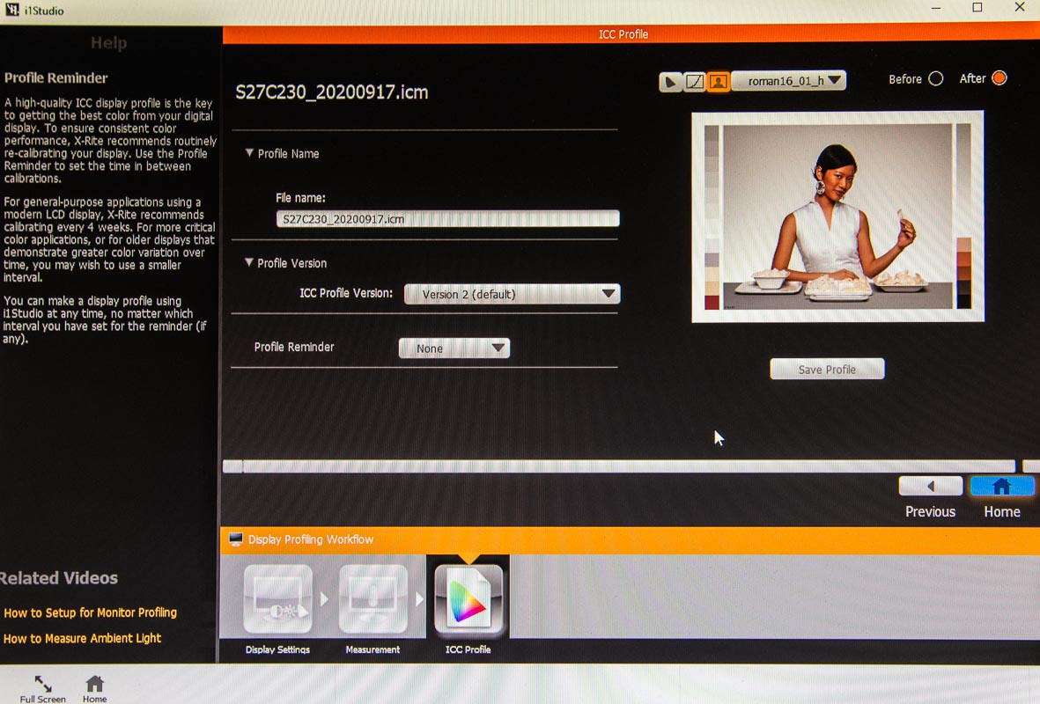
Display Calibration

Slide 37
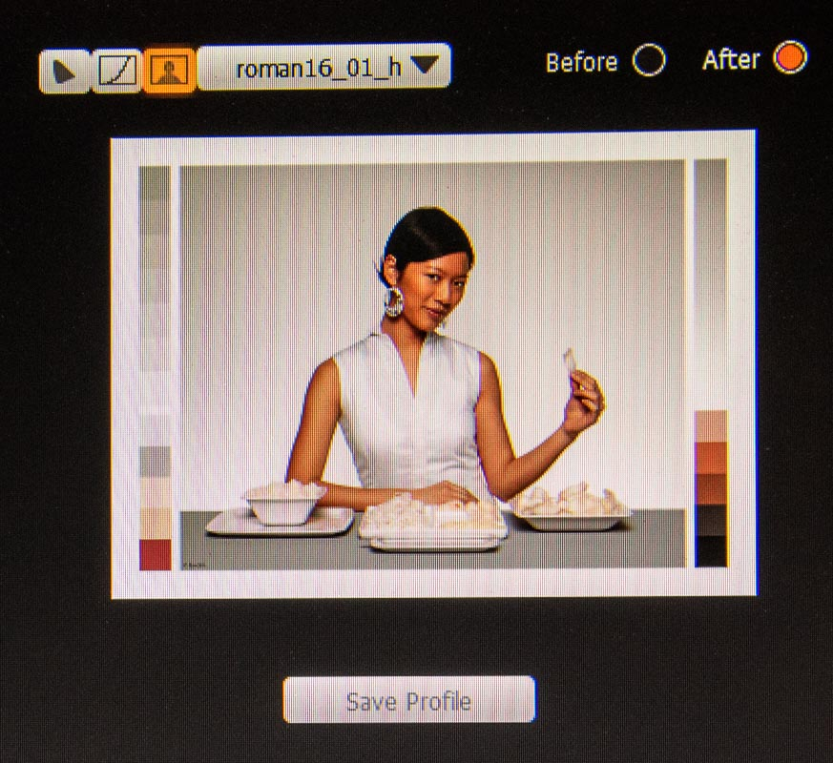
Display Calibration
View Before and After

Slide 38
Display Calibration
This completes display calibration.
Your computer will automatically use the saved profile every time you turn on the computer, or reboot.

